Slide 1


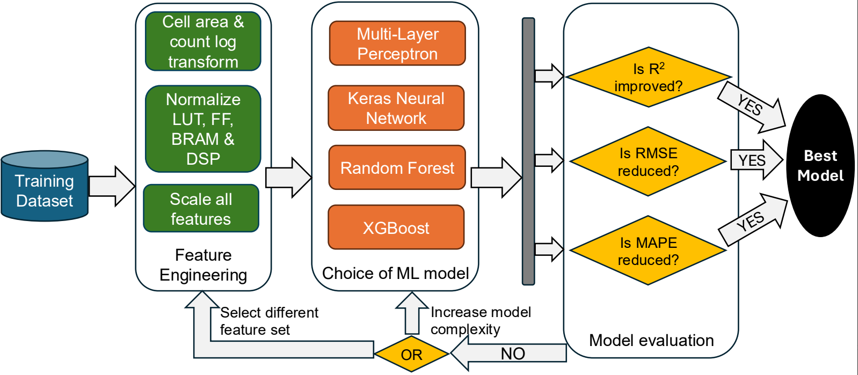
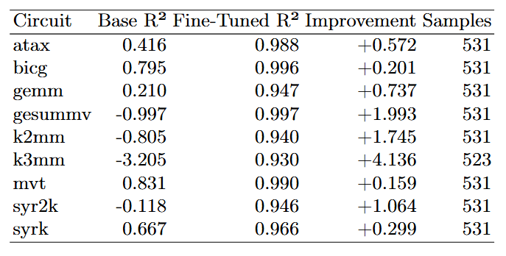
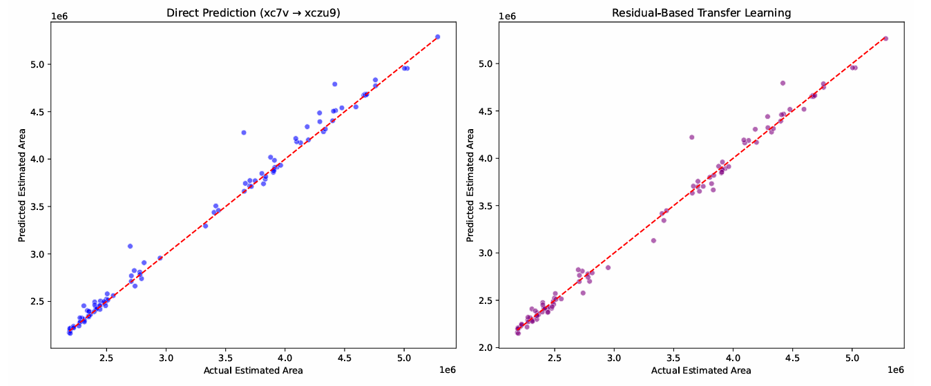
MARU: An ML-Based Framework for Area Estimation from FPGA Resource Usage
Tarun Kholay, Anup Ashok Kedilaya,Aman Arora, Jaydeep P. Kulkarni, Lizy K. John
Electrical & Computer Engineering, The University of Texas at Austin
School of Computing and Augmented Intelligence, Arizona State University
Introduction
Why Current FPGA Metrics Fail
Modern FPGA design evaluations rely on heterogeneous resource counts:
  LUTs, FFs, DSPs, BRAMs are not interchangeable
  Cross-design and cross-platform comparisons are ambiguous
  Research results and benchmarks become hard to interpret
Cell Area provides a unified, comparable metric that enables fair evaluation
Key Insight: Machine Learning can learn the nonlinear relationship between FPGA resource usage and ASIC cell area, enabling early, fast, and fair design comparison without running full synthesis and place-and-route.
Methodology
Data Generation Framework
  Extract HLS features from Xilinx Vitis (xc7v & xczu9) using Polybench benchmarks.
  9 circuits, 500+ configurations each (4500+ total samples via pragma variations).
  Input features: LUT, FF, BRAM, DSP counts + engineered features.
  Output labels: ASIC area estimates from Yosys gate-level synthesis with sky130 PDK.
  Clock period set to 10ns for timing aware resource utilization across tools.
Feature Engineering
  9 total features: 4 raw (LUT, FF, DSP, BRAM) + 5 engineered (ratios, log transforms).
  MinMax and RobusScaler for normalization.
  Feature importance analysis: LUT & FF are dominant predictors for area.
  Domain-specific transforms ensures interpretability.
Transfer Learning Strategy
  Direct prediction for known circuit/FPGA combinations.
  Light-weight fine-tuning (20% data, <10min) for new circuits or cross-FPGA.
  Residual based adaptation for handling architectural differences.
Machine Learning pipeline
  Evaluated multiple ML models: MLP, Keras NN, Random Forest, XG Boost.
  Best performance: XG Boost (R²: 0.994, MAPE: 2.26%).
  Bootstrap sampling + K-fold cross-validation for robustness & overfit prevention.
  90/10 train/test split for model validation.
Results
Experiment 1: Same Suite, Same FPGA (80/20 cross-validation)
  XGBoost achieves best performance: R²=0.994, MAPE=2.26%.
Experiment 2: Cross-Suite, Same FPGA
  Direct prediction degrades: R² for compute-intensive K3MM circuit is -44.55 and MVT (0.32).
  Transfer learning improves accuracy R² by >90%. Light-weight fine-tuning enables robust cross-circuit predictions.
Experiment 3: Same Suite, Cross-FPGA
  Residual based transfer learning improves R² 0.982.
  Largest gains seen in compute-intensive kernels (K3MM & K2MM).
  Demonstrates architecture-aware adaptation capabilities.
Experiment 4: Multi-Suite, Same FPGA
  Direct prediction shows degradation across all circuits with negative accuracy (R²) values.
  Fine-tuning with 50% data improves R² across all circuits with average of 0.964.
  Largest accuracy improvements in compute-heavy circuits (2%-3.5%).
Experiment 5: Multi-Suite, Cross FPGA
  Multi-circuit model generalizes well across FPGA with direct prediction of 0.895.
  Residual-based transfer learning improves R² to 0.925.
  Validates scalability and reusability of learned patterns.
Multi-Suite, Same FPGA Area Estimate (Experiment 4)
Direct prediction shows poor performance across unseen circuits, but fine-tuning consistently restores high accuracy (R² ≈ 0.96 average), with the largest gains in compute-intensive kernels.
Multi-Sute, Cross-FPGA Area Estimate (Experiment 5)
Learned area–resource relationships transfer across FPGA generations, with residual-based fine-tuning improving robustness and reducing absolute error.
Feature Name | Description/Formula
LUT | Number of look-up tables used
FF | Number of flip-flops used
DSP | Number of DSP slices used
BRAM | Number of Block RAMs used
LUT_FF_ratio | LUT/(FF+1)
Total_resources | LUT+FF+DSP+BRAM
DSP_LUT_ratio | DSP/(LUT+1)
Log_LUT | Log(1+LUT)
Log_FF | Log(1+FF)
Exp | Type | Method | Configuration | Average R²
1 | Same Suite, Same FPGA (80/20) | Baseline | A(V) variants | 0.994
2 | Cross-Suite, Same FPGA | Direct | A(V)→B,G,M,K,S(V) | 0.32
 |  | Fine-tuned | A+X’(V)→X(V) | 0.99
3 | Same Suite, Cross-FPGA | Direct | A(V)→A(Z) | 0.97
 |  | Transfer | A(V)+A’(Z)→A(Z) | 0.982
4 | Multi-Suite, Same FPGA | Leave-one-out | 8×(V)→1×(V) | -0.37
 |  | Fine-tuned | 8×+X’(V)→X(V) | 0.96
5 | Multi-Suite, Cross-FPGA | Direct | 8×(V)→A(Z) | 0.895
 |  | Fine-tuned | 8×(V)+A’(Z)→A(Z) | 0.925
Conclusions
MARU introduces a fast, learning-based framework for estimating ASIC-equivalent area directly from FPGA HLS reports.
By leaning the nonlinear relationship between FPGA resource usage and gate-level area, MARU enables fair cross-design and cross-platform comparisoin while reducing evaluation time from days to minutes.
This makes MARU a practical tool for early design space exploration, benchmarking, and FPGA-to-ASIC migration analysis.
Feature list for ASIC cell area prediction
A=atax, B=bicg, G=gemm/gesummv, M=mvt, K=k2mm/k3mm, S=syrk/syr2k. V=xc7v, Z=xczu9.

